Slide 1
Modern Circumstances:
Presented by :
Meg Black, PhD
Handmade paper on the front lines to combat climate change.

Slide 2
About the Presenter: :
Meg Black has been using abaca to create textured paintings and sculptures for over thirty-five years. Her focus on nature’s palette, detailed compositions, and atmospheric perspective yields stunning landscapes, seascapes, and garden views. Her abaca pulp paintings are acclaimed for their textured surface and colorful luminosity by private and public collectors alike.
Meg received a PhD. in Education from Lesley University, an MFA in Studio Art from the Massachusetts College of Art, and a BFA from the State University of New York, Oswego. She has extensive teaching experience including as a visiting instructor at the Studio Art Center International in Florence, Italy. Until recently, she was the Coordinator of Art Education at Salem State University.
Meg’s work has been included in multiple group and solo exhibitions and has been acquisitioned into private, corporate, healthcare, and public collections. Collectors of her work live as far away as Venice, Italy to the remote corners of northern Alaska.

Slide 3
UN For 50 years, the UN Environment Program (UNEP) has offered the world a way forward “based on a vision for a better, healthier Earth built on the pillars of international cooperation,” Secretary-General António Guterres told a landmark special session, commemorating the agency’s golden anniversary.
“The planet was already showing signs of buckling under the weight of humanity” back in 1972 when the agency was founded, he explained to the event in Nairobi via video message.
“In the following decades, UNEP and its partners will work with Member States to combat air pollution, restore the ozone layer, protect the world's seas, promote a green and inclusive economy and raise the alarm about biodiversity loss and climate change”.
UNEP offered the world a new way forward based on a vision for a better, healthier Earth built on the pillars of international cooperation.

Slide 4
It has showed that multilateralism works and can deliver solutions for people and the planet.
UNEP's science, policy work, coordination and advocacy has helped to right environmental wrongs around the world and raise awareness of the critical importance of the environmental dimension of sustainable development.
We need scaled up international cooperation to provide the financial and technical assistance that vulnerable countries and communities need for greater resilience.
We need an ambitious and actionable post-2020 biodiversity framework to put us on a path of living in harmony with nature.

Slide 5
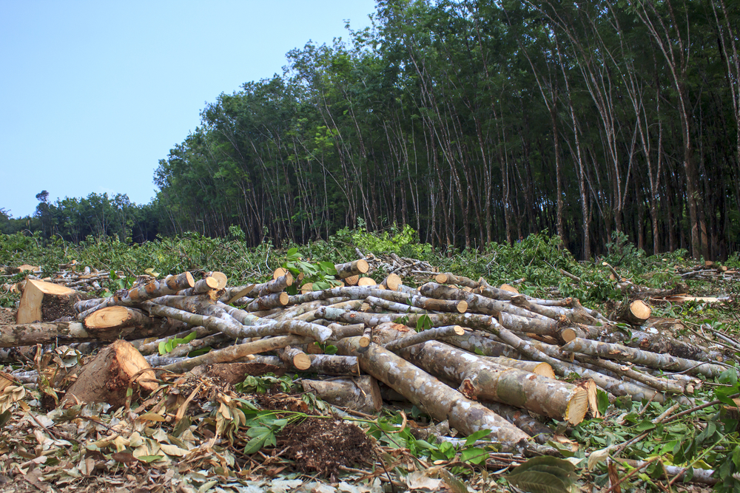
How does the paper industry impact climate change?
The environmental effects of paper production include
deforestation,
the use of enormous amounts of energy
water
air pollution
waste problems.
Paper accounts for around 26% of total waste at landfills.

Slide 6
As an artist, I am interested in theories of beauty.
How can I create beauty in my work?
Using abaca pulp as my medium helped me explore beauty because of its texture and how well it holds pigment, making for vibrant colors and a multi-layered surface.
Coneflowers II (detail).
Meg Black, (2021). Coneflowers II. Abaca painting. 40 x 40 x 4 inches.

Slide 7
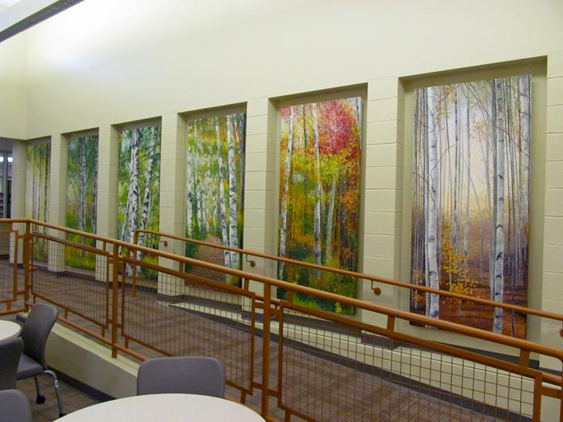
This quest led me to study architectural history, especially when artists and architects collaborated. This research led me to learn more about sustainability in building practices.
Meg Black. Transitions, (2014). abaca pulp paintings. each panel, 84 x 48 inches. Collection, state of New Hampshire. Above: May panel.
Notes:
https://www.instagram.com/megblackstudio/

Slide 8
Sustainability:
Sustainability is an important concept in architecture. I started thinking of sustainability in terms of my own art materials. As much as it is my mission to create beautiful artwork, it is imperative that the materials I use do not inadvertently harm the environment in the process.
Plastic cups and squeeze bottles used to hold beaten abaca. Photo: Kindra Clineff
Modern Circumstances: Handmade paper on the front lines to combat climate change.

Slide 9
With this concern in mind, I read about the positive impact my primary pulp painting medium, abaca, has on the environment and the many creative ways the scientific, medical, corporate, and environmental research communities are using abaca to combat climate change and improve environmental conditions.
Meg Black (2020). Resilience. Abaca painting. 40 x 40 x 4 inches. Private collection.
Modern Circumstances: Handmade paper on the front lines to combat climate change.

Slide 10
What is abaca?
Abaca is a natural leaf fiber that comes from a relative of the banana tree family native to the Philippines that grows throughout tropical regions. It is also called Manilla hemp, though it is not related to actual hemp.
Abaca is generally considered to be a sustainable, environmentally friendly fiber that can empower communities. It has been identified by the United Nations as a “future fiber.”
Source: https://cfda.com/resources/materials/detail/abaca
UNEP: https://www.fao.org/economic/futurefibres/home/why/en/

Slide 11
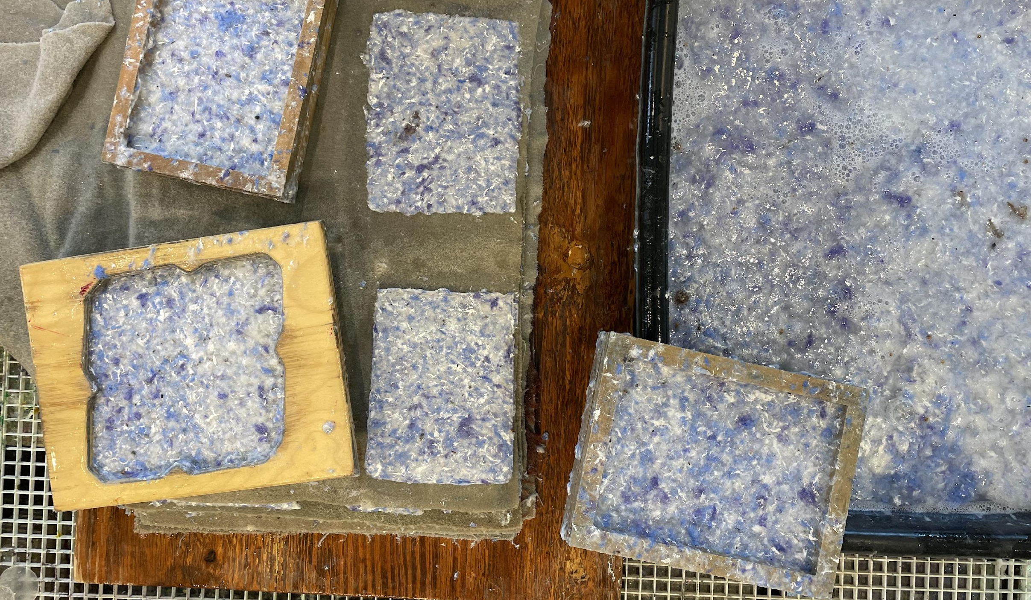
What is abaca used for?
To make paper:
The main application of abaca is specialty paper where around 80% of the fiber is used in manufacturing.
bank notes,
filter paper
cigarette paper. In this area of application, the fiber strength is important for the uses as well.
Other significant properties for the papermaking is the fineness and fiber length. With these properties, it is possible to produce a lightweight paper with high porosity.

Slide 12
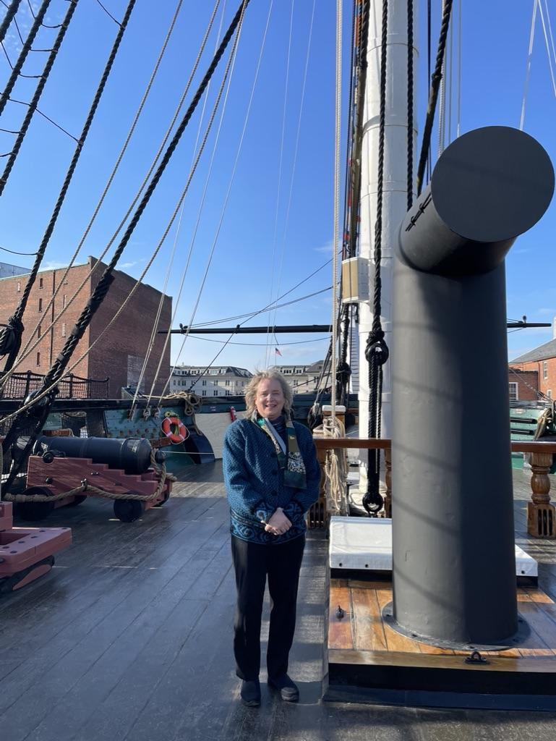
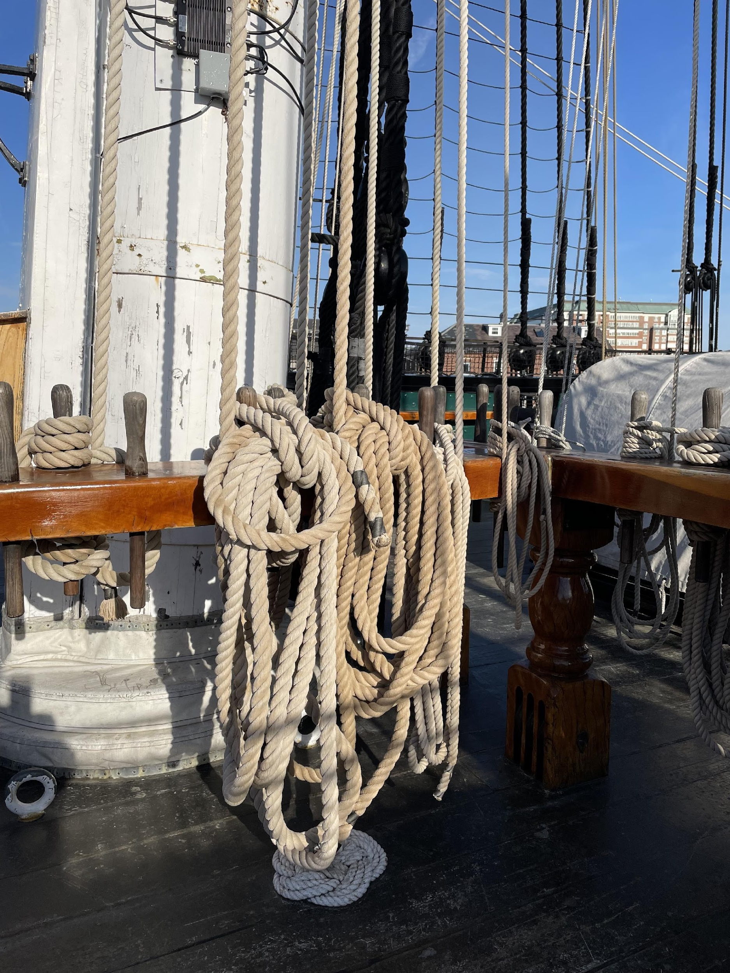
Ropes and cordage:
Abaca is widely used for ships' rigging and pulped to make sturdy manila envelopes. Today, it is still used to make ropes, twines, fishing lines and nets, as well as coarse cloth for sacking.
The US Navy uses abaca for cordage.

Slide 13
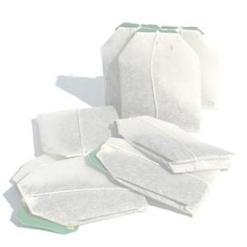
OTHER USES for ABACA:
Food and Beverage: Tea bags | Single serve coffee | Food packaging
Personal care: Feminine hygiene | Adult incontinence | Swim diaper
Building: Decorative laminate | Wall cover | Tiles
Industrial: Industrial wipes | Tape | Filtration
Medical: Face masks | Diagnostic strips | Wound care
Electrical: Lead acid battery | Capacitor
Consumer: Wipes | Table-top | Floor care | Laundry sheets | Shoe insoles
Modern Circumstances: Handmade paper on the front lines to combat climate change.

Slide 14
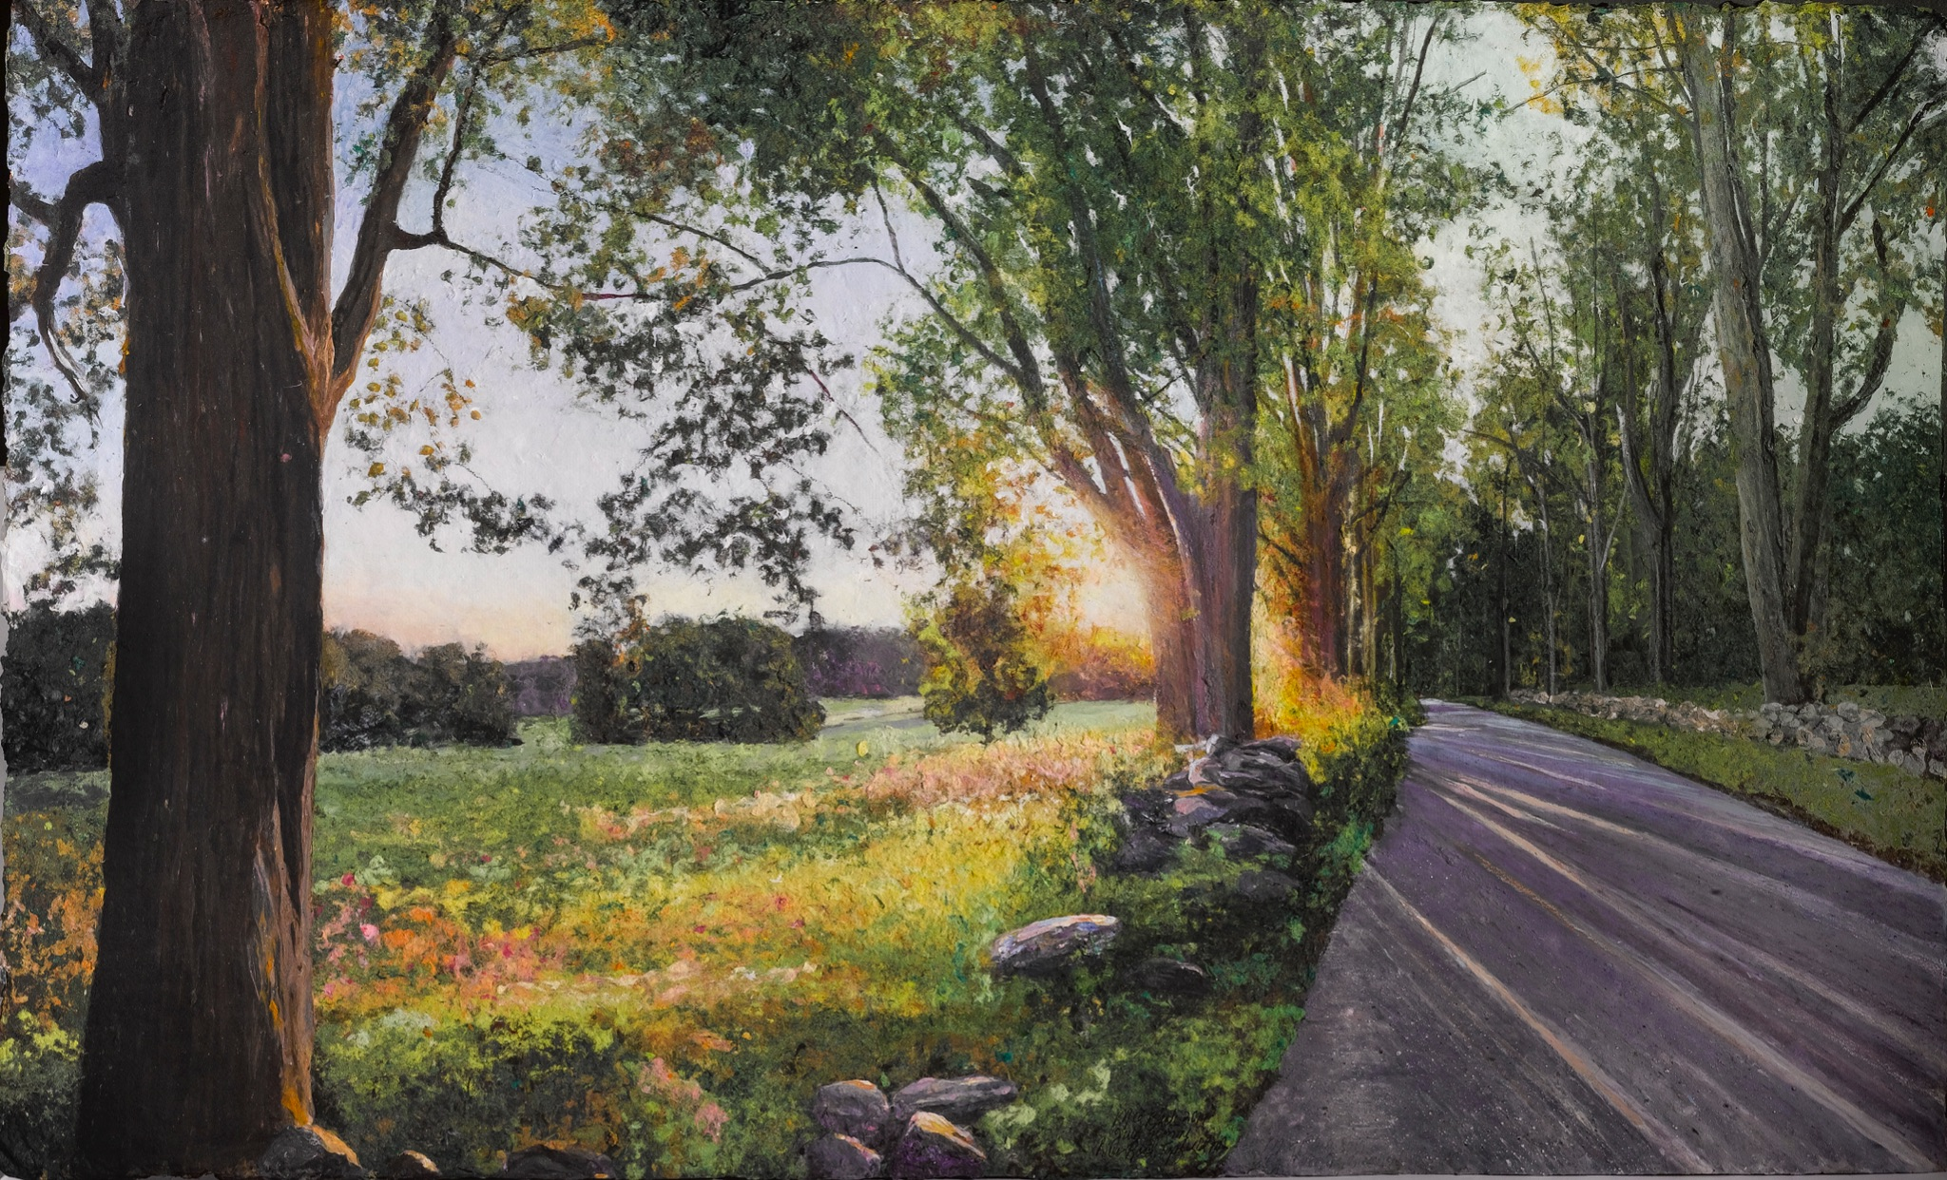
This research has proven beneficial to suit modern circumstances, including climate change; and cultural shifts, such as economies, that can benefit from growing this ancient plant.
Meg Black. July Evening Light, (2019). Abaca painting. 40 x 24 inches.

Slide 15
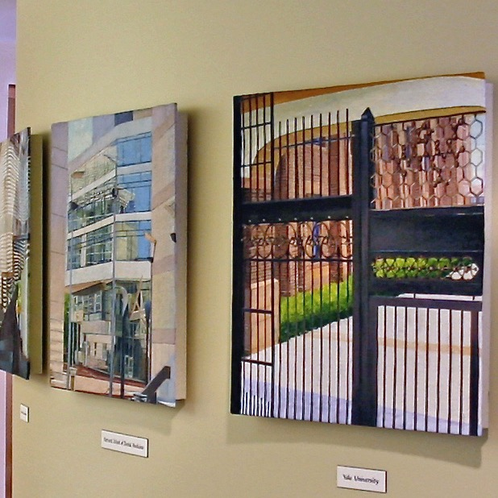
Erosion control and biodiversity rehabilitation can be assisted by intercropping abaca into former monoculture plantations and rainforest areas.
Planting abaca can minimize erosion and sedimentation problems in coastal areas which are important breeding places for fish.
The water holding capacity of the soil will be improved and floods and landslides will also be prevented.
Abaca waste materials are used as organic fertilizer.
The scientific community:
Meg Black (2009). Harvard School of Public Health (left) School of Chemistry, Yale University (right). Abaca paintings. Collection: Berry Contractors.
Modern Circumstances: Handmade paper on the front lines to combat climate change.

Slide 16
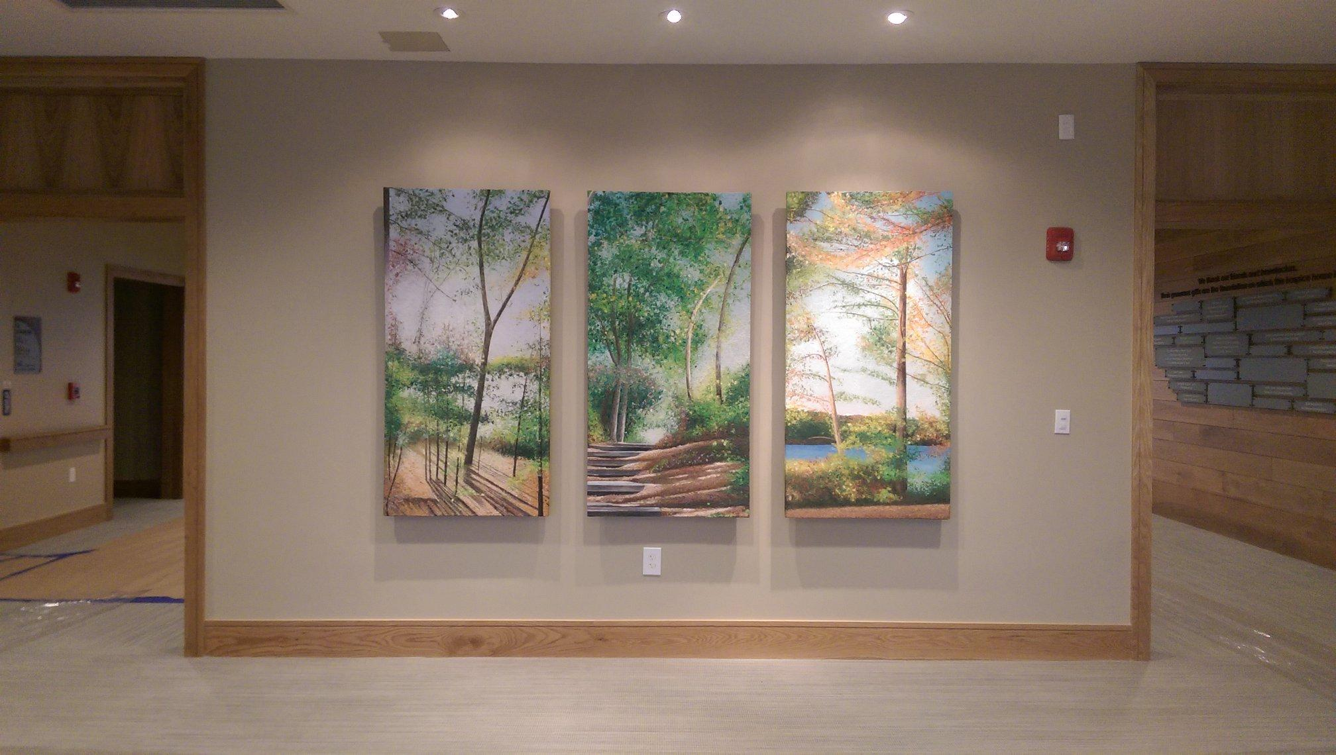
The medical community:
•Abaca was used to make PPE during the pandemic.
•It was used to make disposable hospital gowns.
•It was used to make disposable floor wipes, and biodegradable wipes.
•Disposable slippers.
•These necessary materials helped save lives and keep hospital worker safe.
Meg Black (2007). How paintings tell a Story. Abaca paintings. Collection: Care Dimensions. Inspired by David Henry Thoreau’s book Walden.
.
Modern Circumstances: Handmade paper on the front lines to combat climate change.

Slide 17
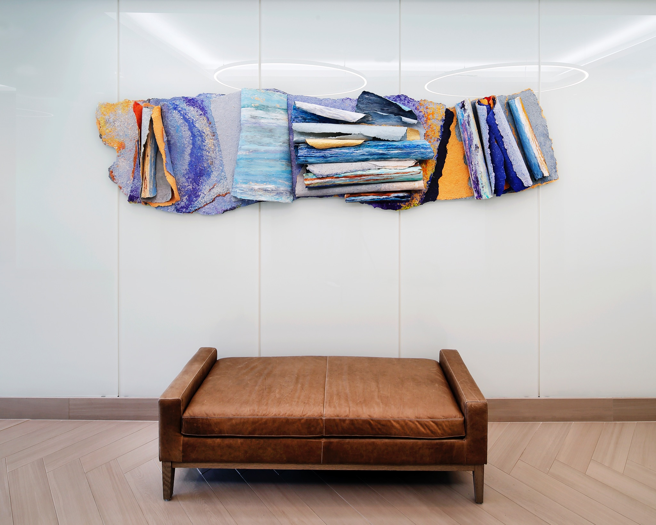
The corporate community:
Currently abaca is being used for ‘soft’ applications in the automotive industry as a filling material for interior trim parts. However, given its inherent strength it can also be used for ‘harder’ applications for exterior semi-structure components as a substitute for glass fiber in reinforced plastic components.
Meg Black (2019) Seafoam. Abaca wall sculpture. 125 x 36 inches. Corporate collection.
Modern Circumstances: Handmade paper on the front lines to combat climate change.

Slide 18
COMPANIES WHO USE ABACA
Abaca fibers are now used in the standard underbody cover for the spare-wheel compartment of the 3-door version of the Mercedes-Benz A-Klasse model.
By using abaca fibers, up to 60% of the energy can be saved as compared to when producing glass fibers, thus significantly reducing CO2 emissions in the manufacturing phase of the raw materials.
The dominant future area for abaca composites belongs to the automotive industry . . .. Fiber reinforced biocomposites has a key role to play within the automotive industry since it offers material with lighter weight, high strength as well as material with a higher share of renewable materials. Furthermore, the production of natural fiber is a process which requires low energy. Incorporating lightweight material in composites such as natural fibers will also result in reducing carbon dioxide emissions by lowering the total weight of the final vehicle.
Source: Abaca in the Philippines
https://kth.diva-portal.org/smash/get/diva2:1352495/FULLTEXT01.pdf
Notes:
The German-American automotive company Daimler Chrysler has a patent for making an abaca reinforced polypropylene composite through a compression molding process 16. This is a biocomposite intended for exterior protection for the underfloor in ordinary passenger vehicles 15. Furthermore one can also find abaca in other parts of Daimler Chrysler produced cars. The company also uses an abaca reinforced polypropylene material for covering the spare wheel in some of their products 2 .

Slide 19
THE FUTURE OF ABACA:
Owing to the extremely high mechanical strength of the fiber as well as its length, application of abaca even in highly stressed components offers great potential for different industrial applications.
Aerospace materials
Robotics
Eco friendly consumer materials
Green engineering technologies
Morning Sunrise, (2021). Abaca painting. 30 x 22 inches. Photo: Kindra Clineff
Notes:
industries participate in this.

Slide 20
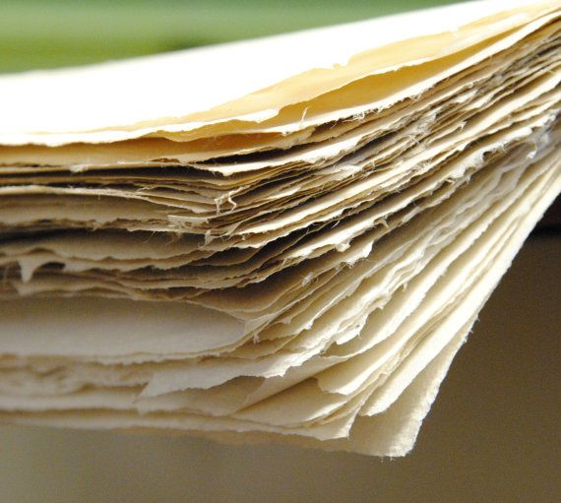
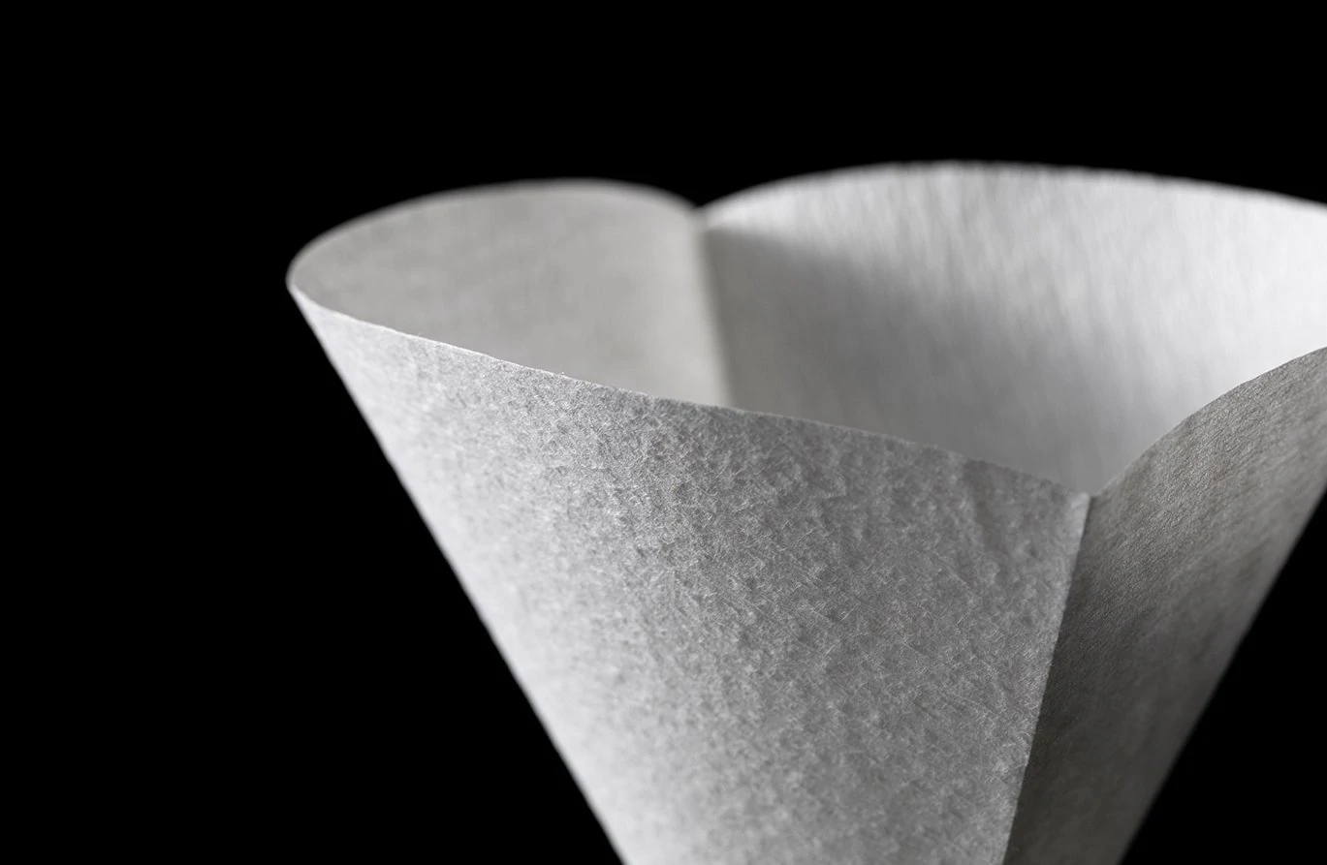
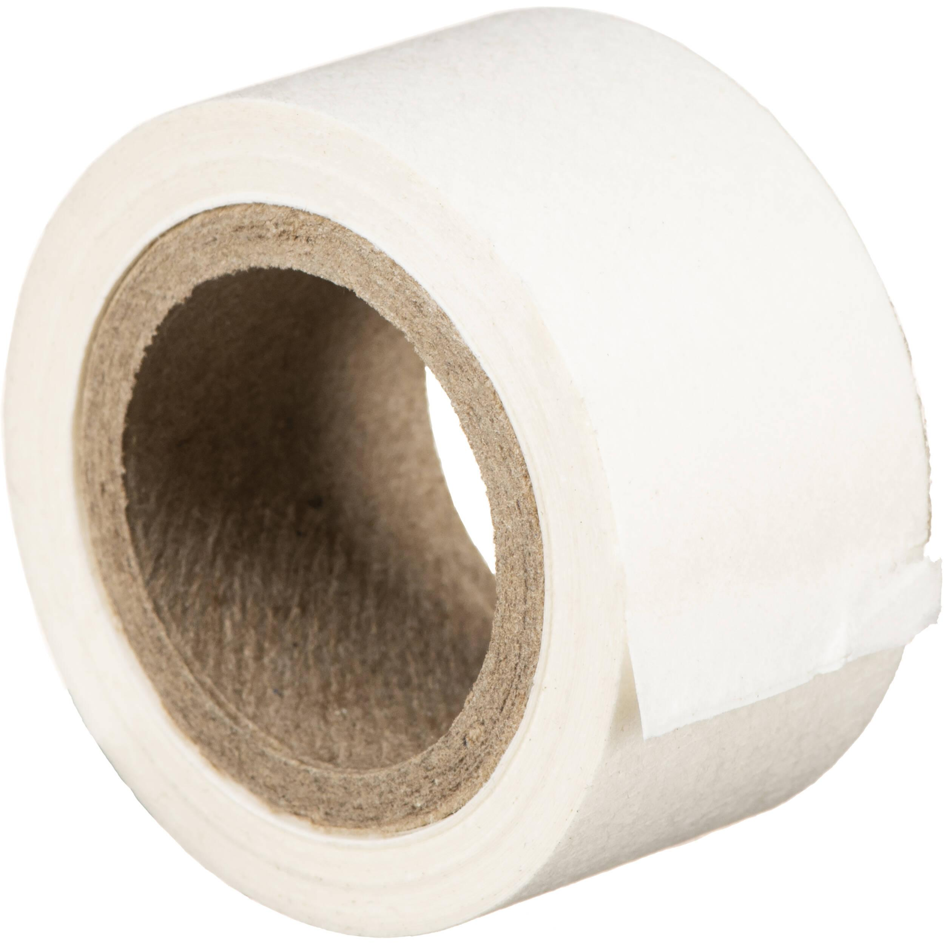
THE FUTURE OF ABACA, continued:
Abaca is proved to be applicable for many diverse areas and the applications is still growing in number, expanding to new markets. Even though abaca has a long history, it is a resource of the future. As a renewable and relative fast-growing source, it has potential of being of great importance for a sustainable future of renewable materials. First and foremost, it could contribute to becoming less dependent on fossil fuel by acting as a substitute for fossil fuel-based materials.
wallpaper
paper
Coffee filers
Hinging tape

Slide 21
Where did I learn about the positive impact of abaca on the environment?
•I posted what I was learning on LinkedIn using the hashtag #abaca.
•Soon, I started receiving comments from a young woman in the Philippines whose family owns an abaca farm.
•We began a trans-continental friendship. She shared with me many articles about abaca that informed my research.
• She shared information about how abaca is sustaining the economies of struggling nations.

Slide 22
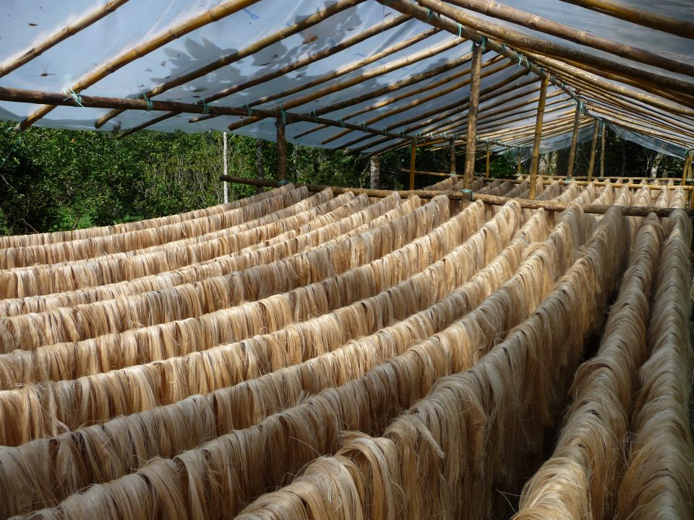
That is how I met Hanna Padilla:
The Managing Director of Fibex,
fibexcorporation@gmail.com

Slide 23
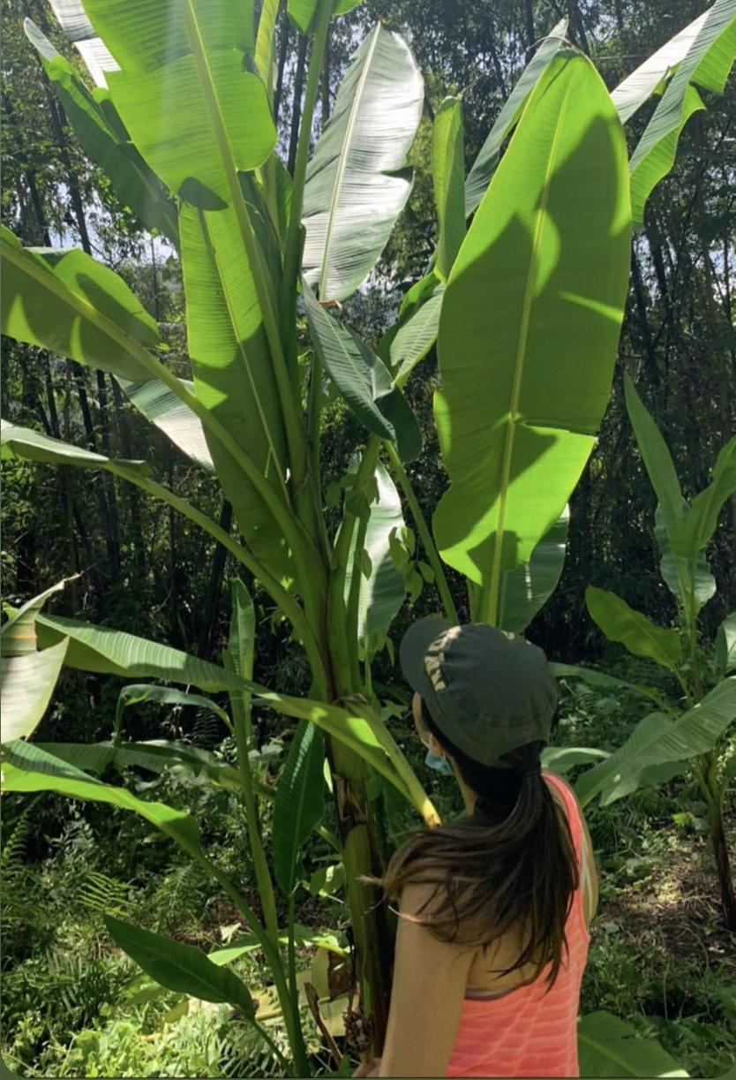
Warehouse operations 2021
Abaca plant on our farm taken 2020

Slide 24
ADVANTAGES:
Minimize erosion and sedimentation problems
Prevention of floods and landslides
Waste materials are used as organic fertilizer
Finished products are durable and eco friendly
PPE decomposes in 2 months
Supports the livelihood of indigenous people and farmers
Notes:
Planting abaca can minimize erosion and sedimentation problems in coastal areas which are important breeding places for sea fishes.
The water holding capacity of the soil will be improved and floods and landslides will also be prevented.
Abaca waste materials are used as organic fertilizer
Manufactured products from Abaca are durable and eco friendly
Abaca use supports the livelihood of indegenous people and farmers

Slide 25
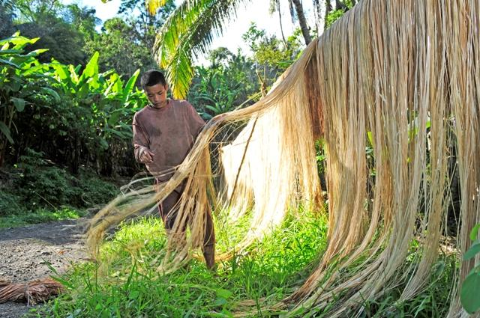
How abaca offsets the effects of climate change

Slide 26
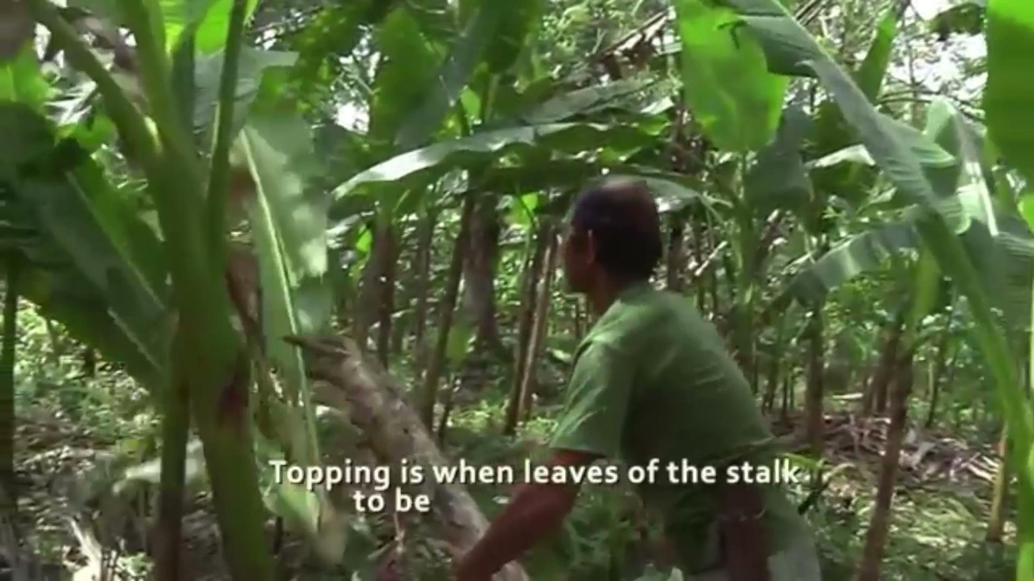
BENEFITS TO LOCAL ECONOMIES:
For the past half-decade, the Abaca industry helped boost the Philippines’ economy from its export earnings with an annual average of P4. 7 billion (94M USD).
Mostly in the Visayas and Mindanao Islands
Abaca fibers are cultivated across 176,549 hectares of farmlands by over 122,758 farmers

Slide 27
Questions? Please follow us!
fibexcorporation@gmail.com
https://www.linkedin.com/company/fibex-corporation
www.megblack.com-join my mailing list. meg@megblack.com

Slide 28
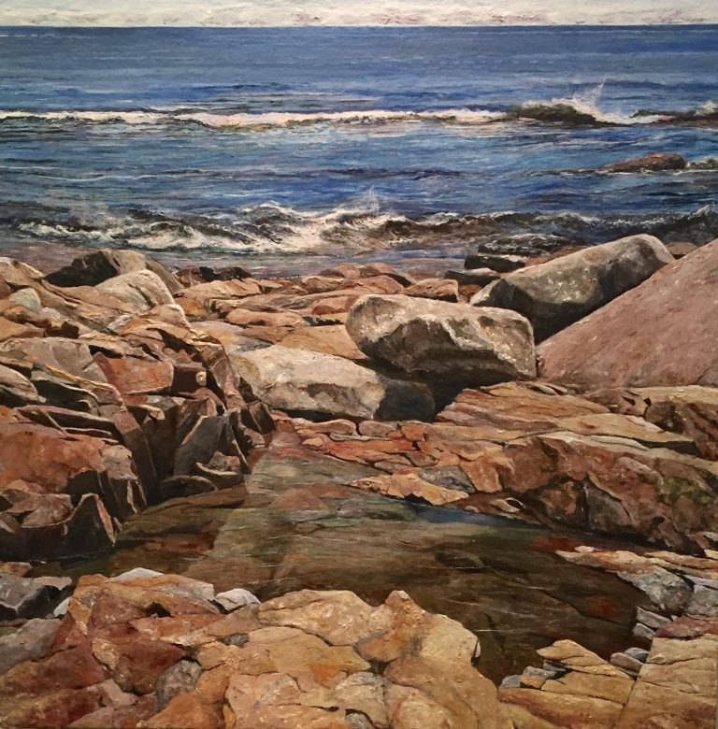
COMPANIES WHO USE ABACA
Abaca fibers are now used in the standard underbody cover for the spare-wheel compartment of the 3-door version of the Mercedes-Benz A-Klasse model.
By using abaca fibers, up to 60% of the energy can be saved as compared to when producing glass fibers, thus significantly reducing CO2 emissions in the manufacturing phase of the raw materials.
The dominant future area for abaca composites most certainly belongs to the automotive industry since this is the main area of growth for bio-based composites, uppermost, material for interior components are coveted 15. Fiber reinforced biocomposites has a key role to play within the automotive industry since it offers material with lighter weight, high strength as well as material with a higher share of renewable materials 15. Furthermore, the production of natural fiber is a process which requires low energy 14. Incorporating lightweight material in composites such as natural fibers will also result in reducing carbon dioxide emissions by lowering the total weight of the final vehicle.
Source: Abaca in the Philippines
https://kth.diva-portal.org/smash/get/diva2:1352495/FULLTEXT01.pdf
Meg Black, (2018). Rocks and Water as Metaphor for Life's Journey. Abaca painting. 40 x 40 x 3 inches.
Notes:
The German-American automotive company Daimler Chrysler has a patent for making an abaca reinforced polypropylene composite through a compression molding process 16. This is a biocomposite intended for exterior protection for the underfloor in ordinary passenger vehicles 15. Furthermore one can also find abaca in other parts of Daimler Chrysler produced cars. The company also uses an abaca reinforced polypropylene material for covering the spare wheel in some of their products 2 .

